Slide 1
DOMAIN-SALESFORCE DEVELOPER USECASE - Creation Of An Application For School Management
TEAM MEMBERS MENTOR- Mr.R.AYYAPPAN
DINESH M SPOC- Mr.T.KARTHIKEYAN
NARAYANASAMY R
SUSMITHA V
NAVEEN KUMAR S

Slide 2
WHAT IS SALESFORCE?
>Salesforce a is CRM platform and its an saas Cloud . Apart from this, It is game-changing technology, with a host of productivity- boosting features, that will help you sell smarter and faster.
>Salesforce has everything you need to run your business from anywhere. Using standard products and features, you can manage relationships with prospects and customers, collaborate and engage with employees and partners, and store your data securely in the cloud.
>Salesforce is your customer success platform, designed to help you sell, service, market, analyze, and connect with your customers.

Slide 3
Creation Of An Application For School Management
Creating a School Management Application using Salesforce involves leveraging the Salesforce platform's various tools and features to build a customized solution tailored to the specific needs of school.

Slide 4
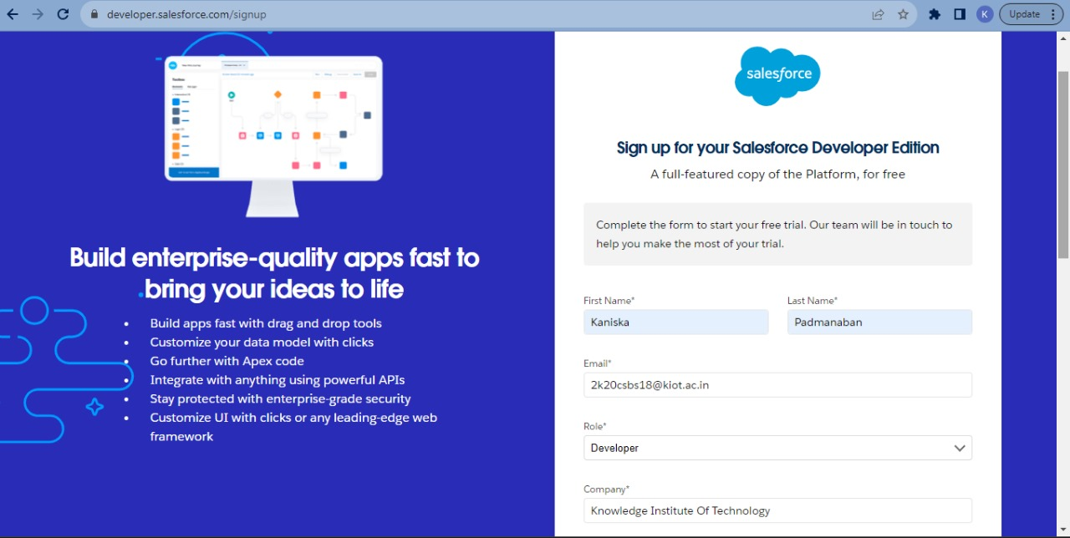
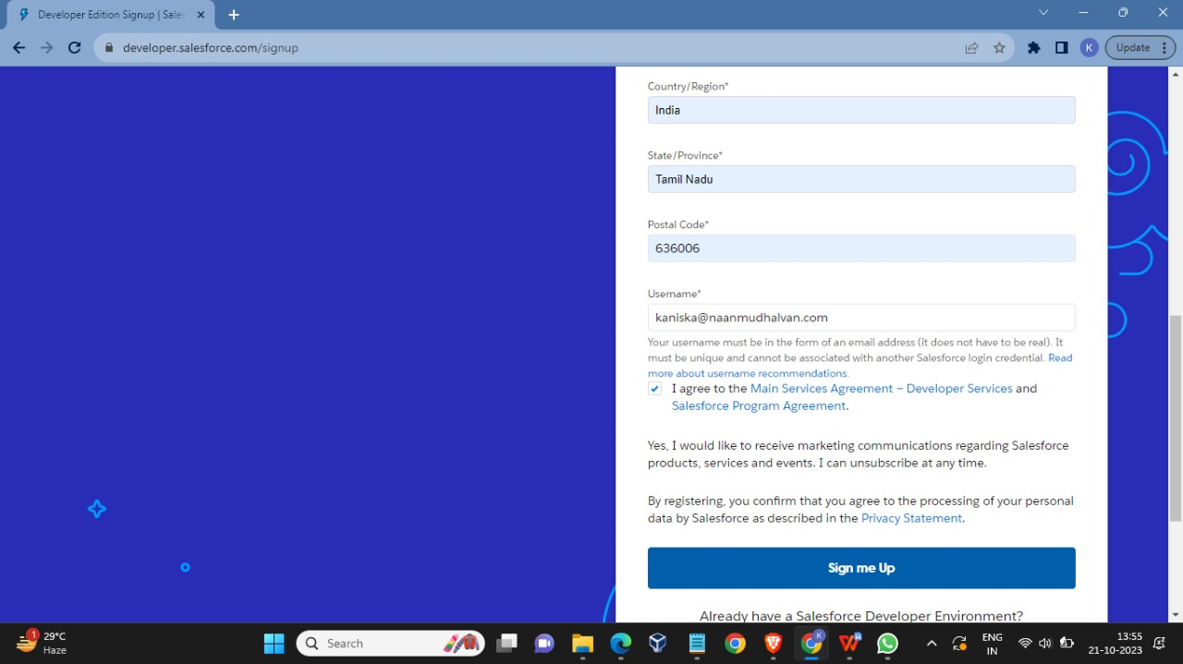
CREATION OF DEVELOPER ACCOUNT
>A Developer org has all the features and licenses you need to get started with Salesforce.
>Search developer.salesforce.com/signup

Slide 5
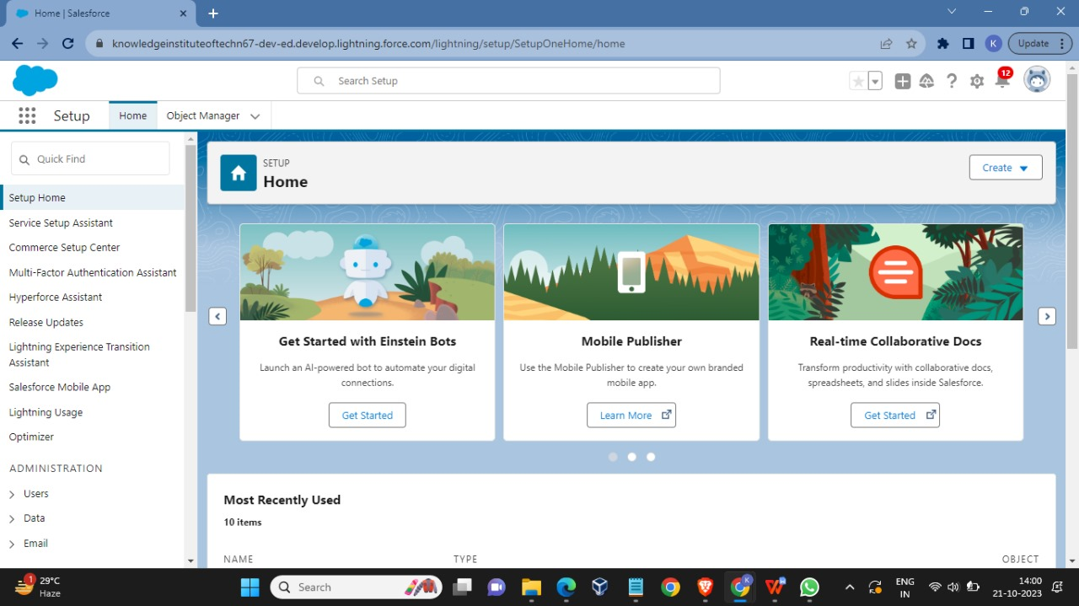
HOME PAGE

Slide 6
Object:
Salesforce objects are database tables that permit you to store data that is specific to an organization. Salesforce objects are of two types: Standard Objects: Standard objects are the kind of objects that are provided by salesforce.com such as users, contracts, reports, dashboards, etc.
Creation Of School Object:
For this school management we need to create 3 objects School, Parents and Student. The below steps will assist you in creating those objects.

Slide 7
> Create Parent Object
> Create Student Object
> Create The School Management App
> Creation Of Fields For The School Objects
> Creation Of Fields For The Student Objects
> Creation Of Fields For The Parent Objects
> Creation On Profile
> Creating A User
> Create Record (School)
> Create Report

Slide 8
Users
A user is anyone who logs in to Salesforce. Users are employees at your company, such as sales reps, managers, and IT specialists, who need access to the company's records. Every user in Salesforce has a user account.
Permission Sets
A permission set is a collection of settings and permissions that give users access to various tools and functions. Permission sets extend users' functional access without changing their profiles.
FLOWS
Record-triggered flows are a powerful automation tool in Salesforce that can streamline business processes,
reduce manual work, and improve productivity. They can be used to automate a wide range of tasks, from simple
to complex, and can be tailored to meet the unique needs of your organization.

Slide 9
Lightning App
Apps in Salesforce are a group of tabs that help the application function by working together as a unit. It has a name, a logo, and a particular set of tabs. The simplest app usually has just two tabs.
Profile
A profile is a group/collection of settings and permissions that define what a user can do in salesforce. A profile controls “Object permissions, Field permissions, User permissions, Tab settings, App settings, Apex class access, Visualforce page access, Page layouts, Record Types, Login hours & Login IP ranges

Slide 10
Reports
Reports in Salesforce is a list of records that meet a particular criterion which gives an answer to a particular question. These records are displayed as a table that can be filtered or grouped based on any field.
Triggers
A trigger refers to an Apex code that is automatically executed before or after certain events occur in the Salesforce platform, such as when a record is inserted, updated, deleted, or undeleted. Triggers are used to automate business processes, enforce data integrity, and perform custom logic on data. A before trigger in Salesforce is executed before the records are actually inserted, updated, or deleted in the Salesforce database. This allows the trigger to perform certain actions or validations before the data is saved to the database.

Slide 11
THANKYOU

